Slide 1

Volunteer Tax Preparation
Orientation
Training, References, Certification, & Support Help

Slide 2
Agenda
Introductions
Overview of Volunteer Tax Prep Program
Steps to Becoming an IRS-Certified Volunteer
Overview of Training and Support Resources
BREAK
Tips and Tricks for Taking IRS Exams
Final Steps and Actually Volunteering
Logins, Logins, Logins!

Slide 3
Introductions
Tell us about yourself!
Name
Pronouns (if you’d like to share)
Where you’re from (if you’d like to share)
How long you’ve been a volunteer (if you’re a returning volunteer)
Why you’re interested in being a tax preparer volunteer

Slide 4
Who are we? What are we doing?
Overview of the Volunteer Tax Prep Program(s)

Slide 5
Who are we?
Volunteers helping taxpayers in our communities with free tax preparation services
We volunteer in the IRS VITA and/or TCE programs
We provide free, high-quality tax preparation services
Tax Counselors are all IRS-certified
We come from all walks of life!

Slide 6
What are VITA and TCE?
The IRS provides support for volunteer tax preparation programs through two different grant programs:
  VITA (Volunteer Income Tax Assistance)
    Focus: Low-income, limited abilities, and limited English-speaking taxpayers
    IRS partners with organizations which run VITA programs
  TCE (Tax Counseling for the Elderly)
    Focus: Older taxpayers
    IRS partners with AARP Tax-Aide, which operates TCE districts and sites across the country
Both programs have the same goal: serve taxpayers in need
Each program has slightly different scopes of service based on their focus

Slide 7
Volunteer Leadership
Both programs are primarily volunteer-led and use a similar leadership structure
Oversees operations, recruitment, and training across all districts in the state (AARP Tax-Aide) or VITA program (MFS CASH Oregon)
AARP Tax-Aide State Coordinator / VITA Program Manager
District Coordinator
Leads a district of tax sites, supports Site Coordinators and volunteers, and helps recruit new volunteers
Site Coordinator
Runs operations of a tax site and supports all volunteers serving there
Tax Preparers, Client Facilitators, Intake Specialists, Interpreters
Interact with taxpayers and prepare tax returns

Slide 8
What are you getting yourself into?
Steps to Becoming an IRS-Certified Volunteer

Slide 9
Disclaimer!
Being a tax preparer is not your average volunteer gig
Expect training and certification to take at least 40 hours between now and early January
  Depending on your existing tax knowledge and technical skills
Need a “stick to it” attitude – it takes work
  But… you will learn a lot and will have friendly, experienced volunteers to help you at every step of the way
Don’t procrastinate
  Tax law is best digested in small amounts to not overwhelm your system

Slide 10




Steps to Becoming an IRS-Certified Volunteer
Study Pub 4961 & Pass First IRS Exam
30 min. - 2 hours
Study Pub 5101 & Pass Second IRS Exam
30 min. - 2 hours
Complete New Tax Preparer Training Course
~30-40 hours
Pass IRS Advanced Certification Exam
3-4 hours
Final District-Specific Training
2-4 hours
Additional Tax-Aide Practice Problems
AARP Tax-Aide
ONLY
Training
Websites:
AARP Tax-Aide
Learning Management System
Oregon VITA and Tax-Aide
Website:
ORTaxaide.org
IRS Link & Learn Home:
https://www.linklearncertification.com/
AARP Tax-Aide
Volunteer
Portal:
Volunteers.AARP.org
Notes:
This diagram shows some of the major steps to certification
We’ll go into a bit more detail of each step so that you understand the major “signposts” on your journey in subsequent slides.
The color coding on this diagram gives you an idea where you register and complete each step.
All of the Green Steps are available via the CASH Oregon Volunteer System (CVS)
- When you see Green, think of Cash
All of the Blue steps are completed on the IRS Link & Learn Website
- When you see Blue, think of the IRS logo.

Slide 11
New Volunteer Learning Map
Handy guide with all certification steps
Includes information on how you can get help with training
Also includes space to write down all of your passwords
(Post link or instructions to access here)

Slide 12
Step 1: Pass First Two IRS Exams
Volunteer Standards of Conduct Exam
Intake Interview and Quality Review Exam
Review questions in advance: IRS Pub 6744, p. 14
Read IRS Pub 4961
Answer questions on paper ahead of time
Take the open-book exam on IRS Link & Learn Certification
Passing grade: 80%
Review questions in advance: IRS Pub 6744, p. 24
Read IRS Pub 5101
Answer questions on paper ahead of time
Take the open-book exam on IRS Link & Learn Certification
Passing grade: 80%
These exams will be available online in mid-November. We will send out an email when they are available.

Slide 13
Step 2: New Volunteer Tax Preparer Training on Moodle
All online, self-paced, and self-study
Course is organized as follows:
  Resource Library
  Tax Preparation Basics
  Case 1: Ames - A Single Taxpayer (TY 2020)
  Case 2: Bautista - A Working Parent (TY 2020)
  Case 3: Cushing - Married Working Parents (TY 2020)
  Case 4: Dodge - A Retired Married Couple (TY 2020)
  Case 5: Grant - What’s New in 2021 (TY 2021)
Course activities include videos, readings, quizzes, and instructions for completing each family’s tax return

Slide 14
Learning Objectives for the Moodle Course
By taking the online Moodle course, you will learn:
Federal and Oregon tax law
How to prepare a tax return using the TaxSlayer software
How to conduct an intake interview with a taxpayer
How to determine if a taxpayer’s return will fall within the scope of your program
How to review a tax return with a taxpayer
Where to go to learn more about tax law when you have questions while preparing a return
Some basic tech tips and tricks that will be helpful in the course and while volunteering

Slide 15
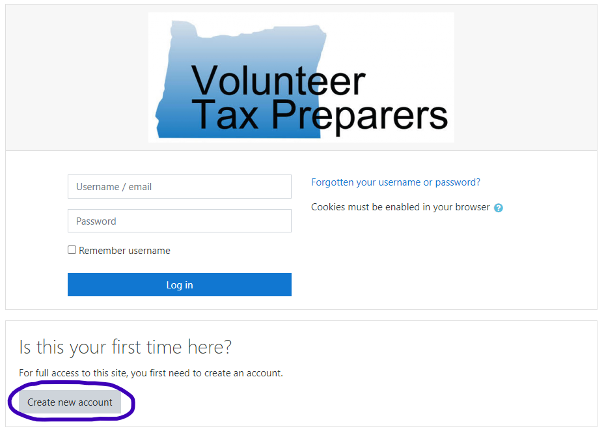
How to Access the Moodle Course
Visit https://learn.mfs-cashoregon.org/my/
Click “Create new account” and add your own email and password

Slide 16
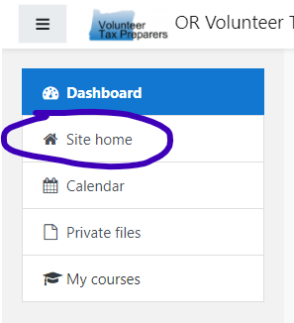
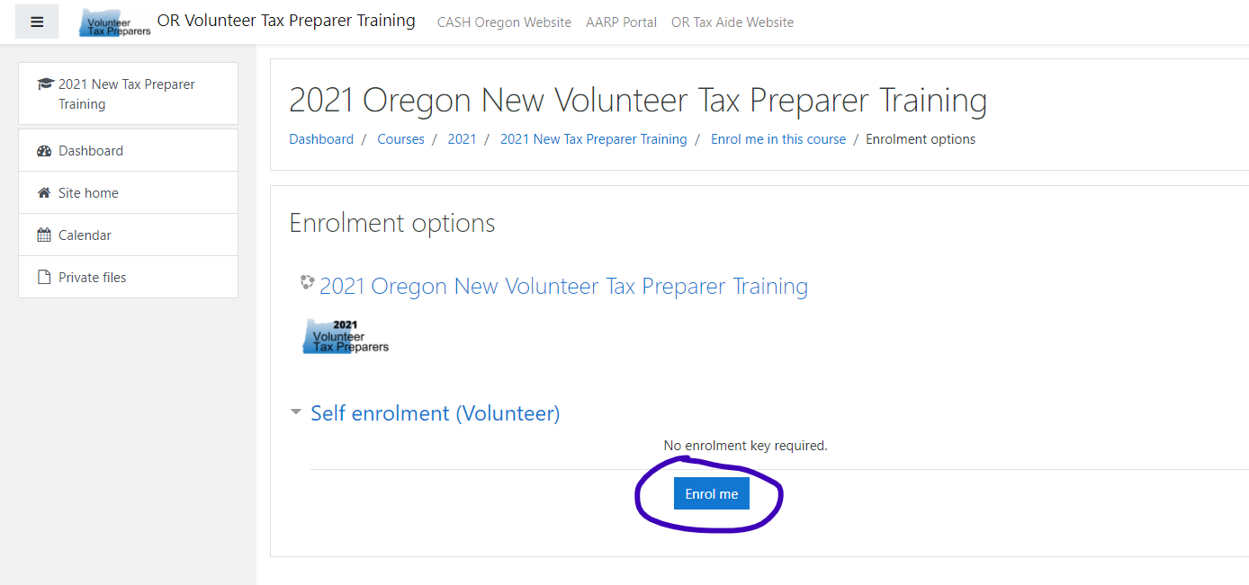
How to Access the Moodle Course
After creating an account, click “Site home” in the top left corner
Under “2021 Oregon New Volunteer Tax Preparer Training,” click “Enrol me”

Slide 17
Starting the Course
Once you are enrolled in the course, it will appear in your dashboard when you log in again
You should start by watching “Start Here! Video: How to Use this Course”
  This will give you an overview of the course and how to navigate through it successfully

Slide 18
Step 3: Pass the IRS Advanced Exam
Review the questions ahead of time
  IRS Pub 6744, beginning p. 74
Refer to your coursework, IRS Pub 4012, IRS Pub 4491, and IRS e-learning to prepare your answers on paper in advance
You will need to use TaxSlayer Practice Lab 2021 for the scenario questions
Take the Advanced Exam on IRS Link & Learn Certification. Passing grade: 80%
When you pass, send your Volunteer Agreement to your District Coordinator

Slide 19
Step 4: Attend a Home Stretch Session with your District
You’ll learn more specifics about how tax prep will work in your district and at your site at the Home Stretch session
Update with information about your district-specific meetings

Slide 20
Step 5: Additional Steps for AARP Tax-Aide Volunteers Only
If you will be volunteering with the AARP Tax-Aide program, you may have additional certification requirements
  Create a profile in the AARP Volunteer Portal
  Complete additional practice problems
  Complete Learning Management System training in the AARP Volunteer Portal
Your District Coordinator will provide more details on these requirements

Slide 21
Help! I’m stuck!
Training and Support Resources

Slide 22
Training Support Resources
Training and certification can be a long and somewhat challenging journey.
Fortunately, you are not alone!
At each step of the journey you will have access to friendly experienced volunteers who can help you navigate the certification process and training resources.
You can get help in three ways:
  Over the phone - Training Support Hotline
  Over Zoom - Office Hours
  Virtual chat room - Student Forum

Slide 23
Help over the phone - Hotline
Call 844-925-4770 (beginning Nov. 15)
One-on-one personal support
Call anytime. If no one is available, leave a message and someone will call back as soon as possible
Learn more in the Moodle Course under “How to Get Help”

Slide 24
Help over Zoom - Office Hour Sessions
Regularly scheduled 90-minute sessions over Zoom
Drop in, drop out at your convenience
Come to ask a question, hear others’ questions, or meet your fellow volunteers
Most sessions will not have a formal agenda
Some may be “themed” to cover a certain topic
You can check the schedule and access a link in the Moodle course under “How to Get Help”

Slide 25
Virtual Chat Room - Student Forum
New volunteers can also ask questions using a virtual chat room in the Moodle course
Experienced volunteers will be monitoring this forum to answer questions
Other new volunteers can also answer
Access the forum in the Moodle course > How to Get Help > Virtual Chat room

Slide 26
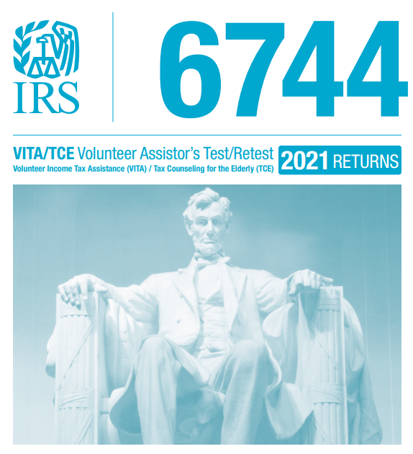
IRS Pub 6744: Exam Questions
Publication 6744
  Contains all of the questions for the 3 required tests:
    Volunteer Standards of Conduct
    Intake/Interview & Quality Review
    Advanced
  Recommend taking the tests on paper first in Pub 6744, then online through Link & Learn
  Must pass all parts @ 80% or better
  Optional tests for Military and International, if you are willing

Slide 27
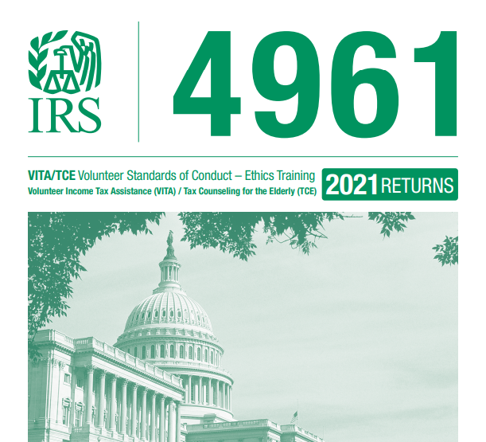
IRS Pub 4961: Standards of Conduct Exam Training
Publication 4961
  VITA/TCE Volunteer Standards of Conduct-Ethics Training
  Training for first IRS certification test
  Six Volunteer Standards of Conduct (VSC)
  Ten Quality Site Requirements (QSR)
  Due diligence and enforcement of VSC & QSR

Slide 28

IRS Pub 5101: Intake/Interview/Quality Review Exam Training
Publication 5101
  VITA/TCE Intake/Interview Quality Review Training
  Training for second IRS Certification Test
  Discusses how to conduct a thorough intake interview with taxpayers and the purpose of the quality review process

Slide 29
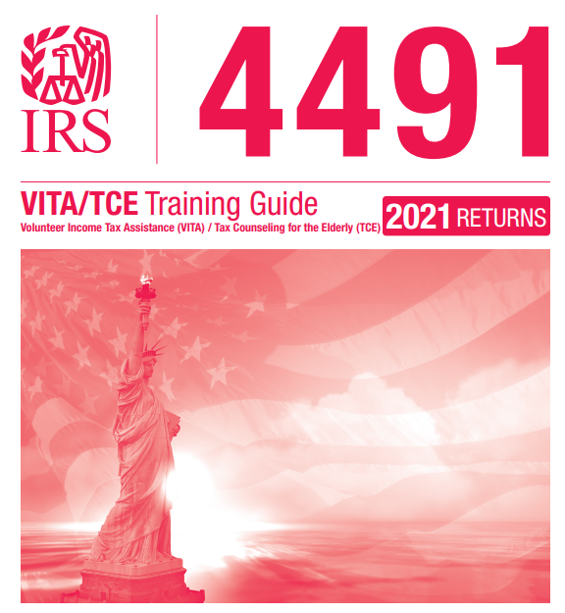
IRS Pub 4491: IRS Training Guide
Publication 4491
  VITA/TCE Training Guide
  In-depth tax law training
  Easy to read and learn tax law
  Your basic “textbook” for the course

Slide 30
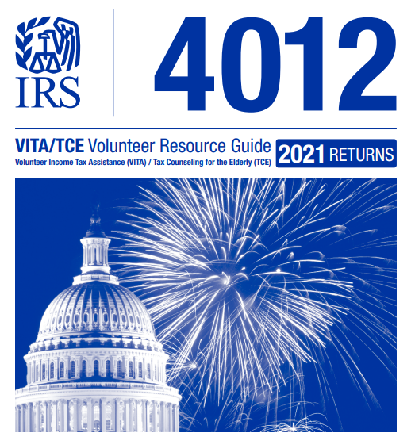
IRS Pub 4012: Main Reference Guide
Publication 4012
  VITA/TCE Volunteer Resource Guide
  Most important quick reference resource
  Used extensively during tax season at your volunteer site
  Needed for your IRS Advanced Exam
  Use the online version for up-to-date information

Slide 31
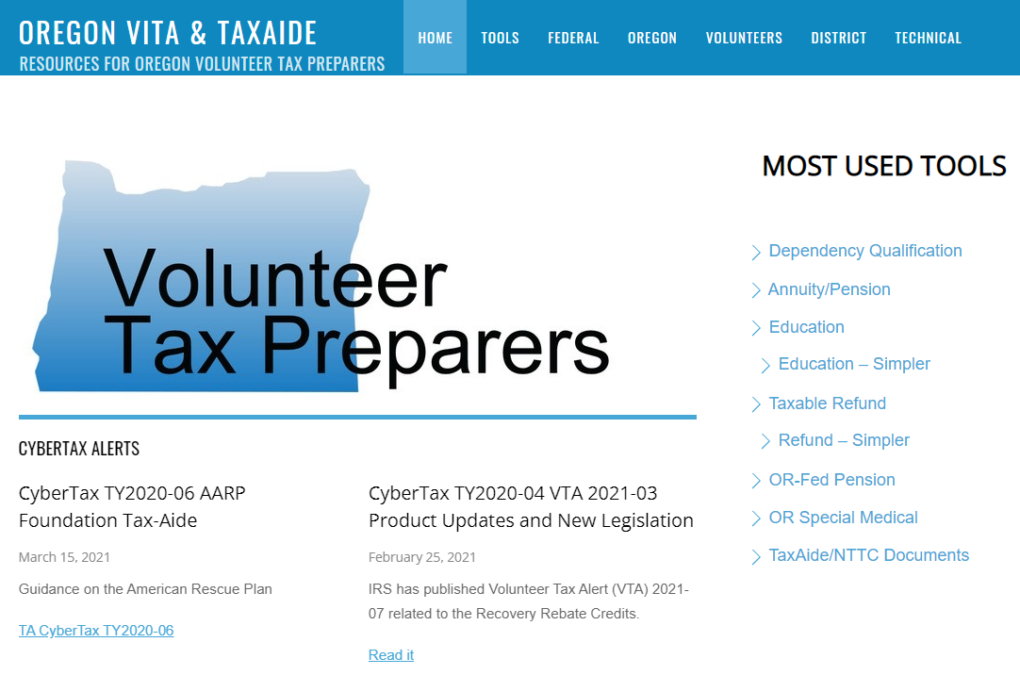
Oregon VITA & Tax-Aide Website
Includes helpful tools, calculators, and other resources
Talk to your District Coordinator for how to access Tax-Aide specific info on website
https://ortaxaide.org/

Slide 32
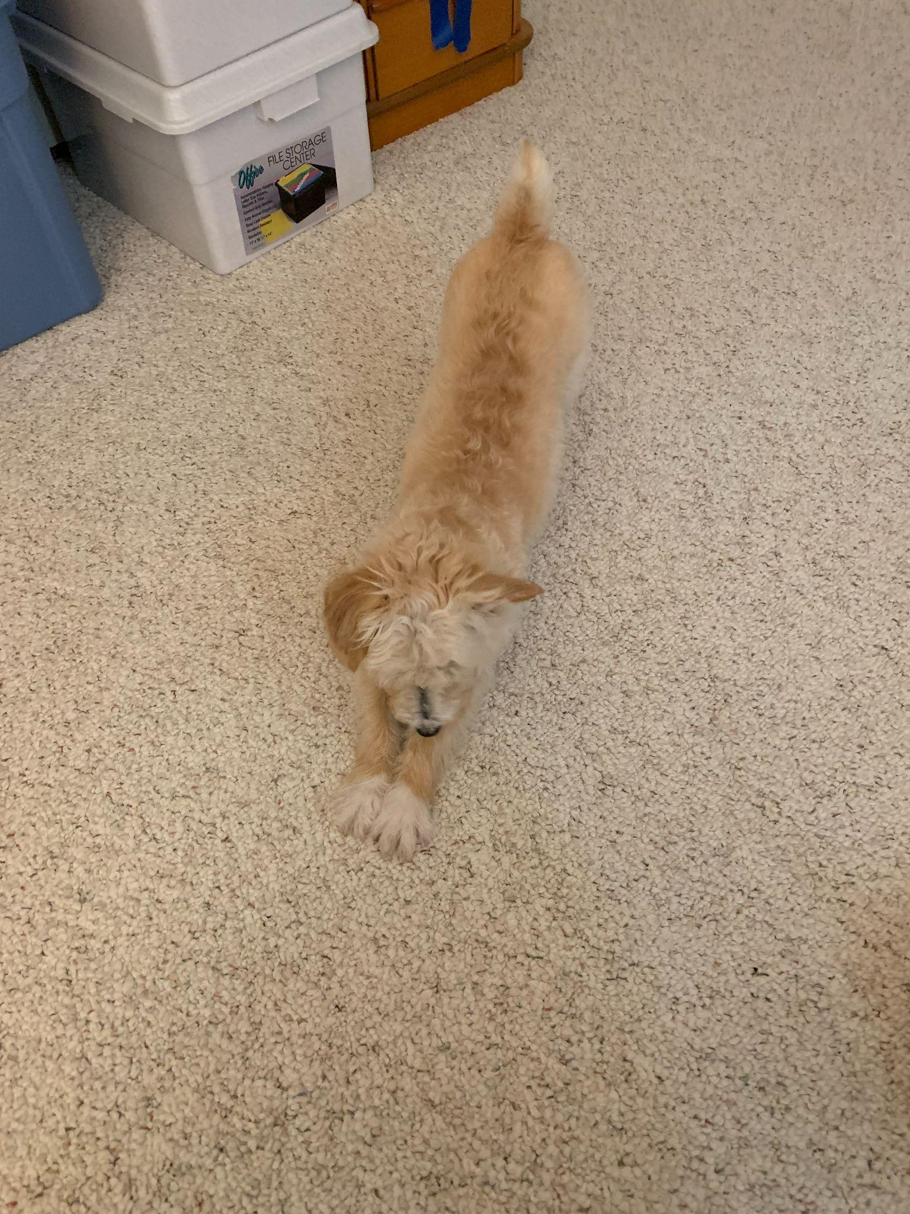
Stretch break!

Slide 33
For the Type A(+) Volunteers
Tips and Tricks for Taking IRS Exams

Slide 34
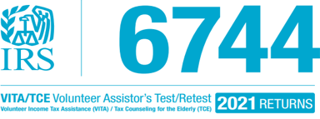
Testing Tips
Publication 6744
  Test/Retest: You get two tries when using Link & Learn to test
    1st attempt is the “test”
    2nd attempt is the “retest”
  Must pass all parts @ 80% or better in only two attempts
  This is an OPEN book test
    Using Pub 6744, work through the scenarios and answer all the questions before taking the test online.
    If in doubt, ASK FOR HELP!
    If you don’t pass on the first attempt, get help before trying again.

Slide 35
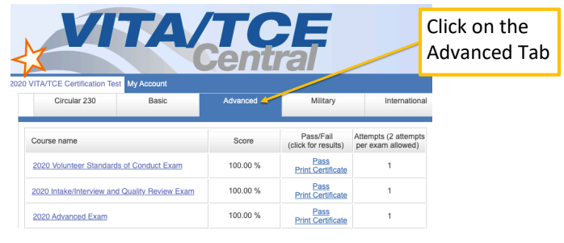
Testing Tips
Link & Learn Certification
  Link & Learn website is where you will take your “real” test
  Come and go here as you need; L&L remembers where you are and saves your progress
  Navigate to the Advanced tab, which will have the three exams you’ll need to take
  Step by step guide on accessing Link & Learn
The 2021 exams will be available online in mid-November. We will send out an email when they are available.

Slide 36
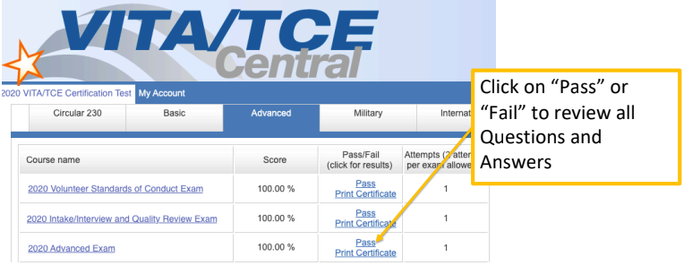
Testing
  Once you submit each test, L&L will give you immediate results for that test
  You can click as shown here to see your answers and those you may have gotten wrong.
  If you fail the first time, you still have a 2nd chance: the Retest. Ask for help!
  More first two exam tips
  More Advanced exam tips

Slide 37
If you don’t pass the second attempt….
If you attempted the Advanced test & retest twice and did not achieve the 80% required to become a Certified Tax Volunteer and
You did pass the Volunteer Standards of Conduct and Intake/Interview & Quality Review with 80% or better and
You still wish to volunteer in the tax program …..
We have other volunteer opportunities for you! Client Facilitators and Intake Specialists are very valuable members of our volunteer team, greeting all of the clients and setting the tone for the site. We cannot do without our CLIENT FACILITATORS.

Slide 38
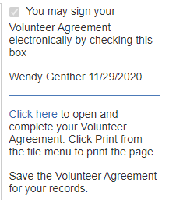
After IRS Exams: Submit your Signed IRS Volunteer Agreement
Congratulations! You passed the test by getting 80% or better.
All the tests show a certificate to print; do this only if you think they are pretty enough for saving for yourself (i.e., we don’t need them)
You will need to email your signed Volunteer Agreement to your District Coordinator; save a copy for yourself as well
You will find this information in the upper right side of the test screen

Slide 39
Now what??? Are we there yet?
Final Steps and Actually Volunteering

Slide 40
What’s Next?
Completed all certification requirements?
You will be offered a volunteer opportunity for days/times that work for you
  Your District or Site Coordinator will give you further instructions for how this site operates for this tax filing season
  You may be assigned a laptop to safeguard and use for tax preparation purposes only; KEEP IT SAFE!
  You will be given access to the live TaxSlayer for your site(s)

Slide 41
Home Stretch Session
In early January you will meet with all volunteers in your district to cover:
  New tax law for 2021
  Operating procedures for sites in your district
  How taxes will be prepared this year
Update with information about your district-specific meetings

Slide 42
Tax Preparation & COVID
Volunteer, taxpayer, and staff safety is the #1 priority!
Districts may offer one or more of the following models this year: (Update with your district’s model(s)
  Traditional – In Person
  Drop-Off
  Scan
AARP Tax-Aide is determining vaccination requirements
  We’ll let you know if/when AARP Tax-Aide makes a decision on vaccine requirements

Slide 43
So… many… passwords...
Logins! Logins! Logins!

Slide 44
Passwords, Passwords, and more Passwords
There will be passwords for everything you will be doing during training, testing, and beyond
KEEP TRACK of your username/password combinations
  Link & Learn
  TaxSlayer Practice Lab
    Site access password: TRAINPROWEB
  Moodle
  AARP Tax-Aide Volunteer Portal (Tax-Aide Only)

Slide 45
Login Demo: Link & Learn
https://www.linklearncertification.com/
Create account
Take three required exams
Generate Volunteer Agreement
PDF: Step by Step Guide to Creating L&L Account

Slide 46
Login Demo: Moodle
https://learn.mfs-cashoregon.org/login/index.php
Create account
Enroll in class
Access class later in dashboard
PDF: Step by Step Guide to Accessing Moodle

Slide 47
Login Demo: TaxSlayer Practice Lab
https://vita.taxslayerpro.com/IRSTraining/en/Account/Access
Main site password: TRAINPROWEB
How to change years
  First four cases in TY2020, last case in TY2021
How to find a return you’ve already started

Slide 48

Ready to volunteer?
Questions?
Comments ...
Notes:
48

